Slide 1
IBM Data Science Capstone Project
Part of IBM Data Science Professional Certificate
Opening a craft beer tap room in Vancouver, BC

Slide 2
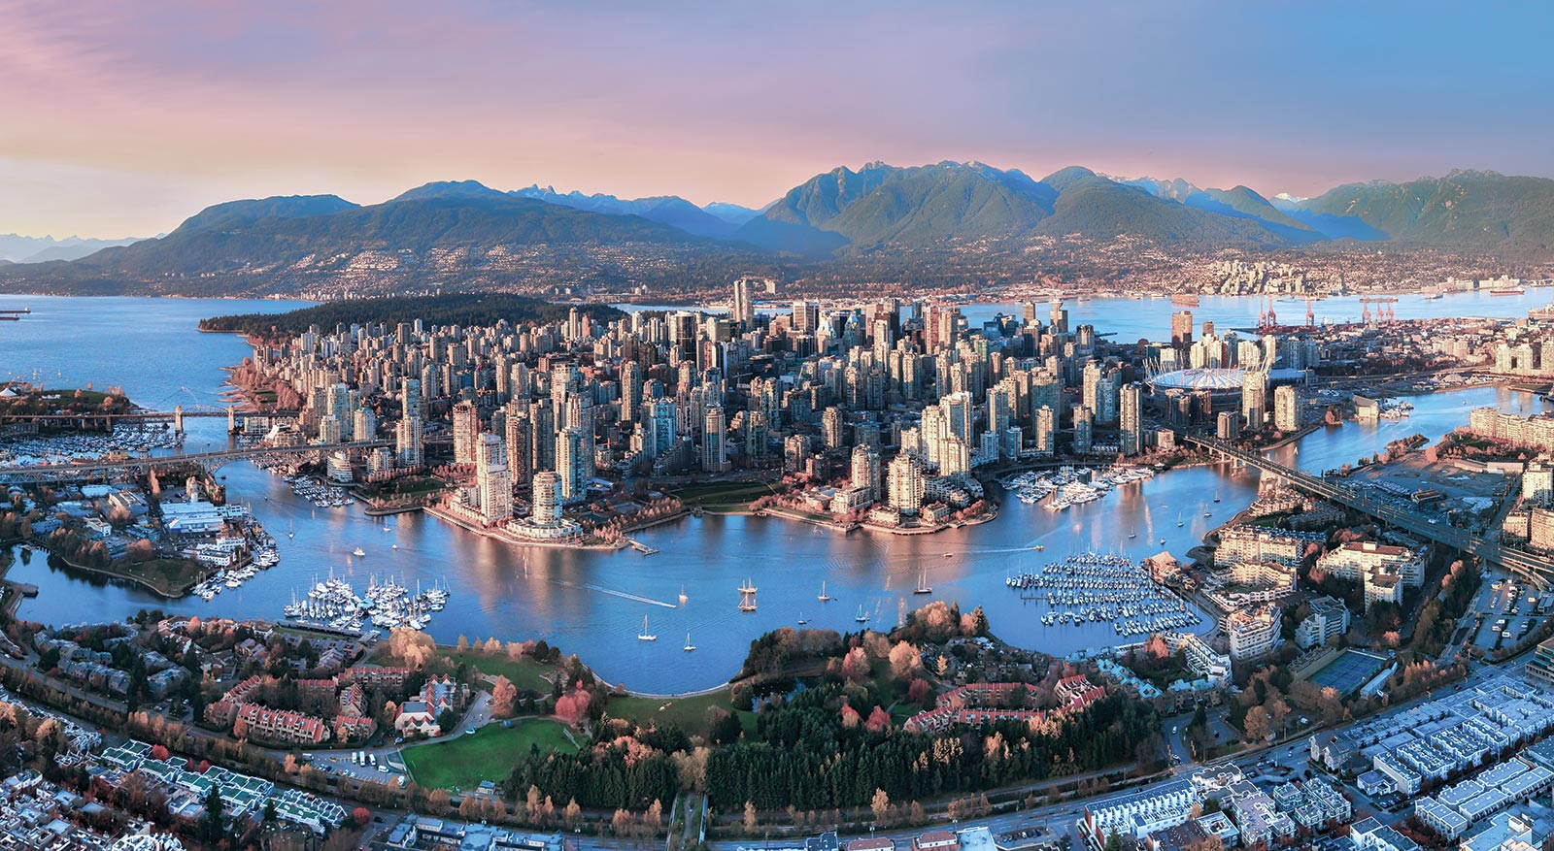
Introduction
Vancouver - one of the most livable cities
Well-established tourism facilities
Good place for investment in hospitality sector
Which area most suitable for craft beer tap room?

Slide 3
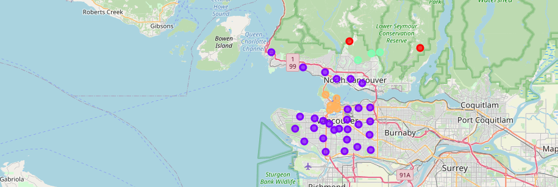
Analysis

Slide 4
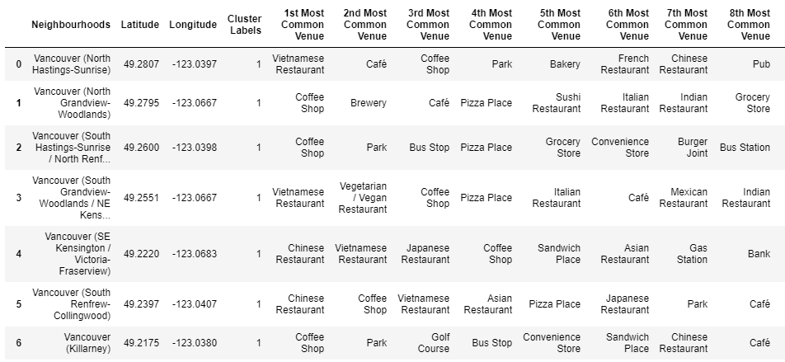
Cluster 1
Residental areas, strong presence of restaurants and cafes

Slide 5
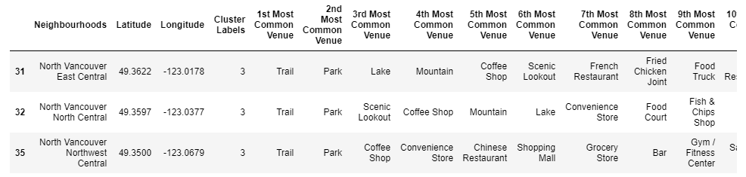
Cluster 2
Hiking trails, touristic amenities

Slide 6
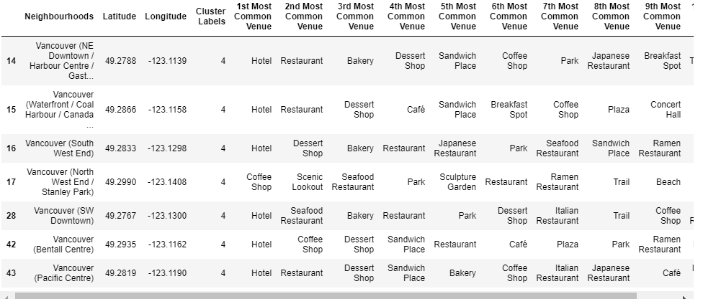
Cluster 3
City center, many tourism facilities: hotels, bars, restaurants

Slide 7
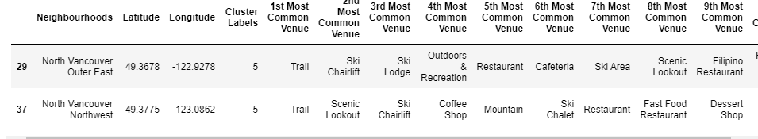
Cluster 4
Hiking trails, ski chairlifts and areas

Slide 8
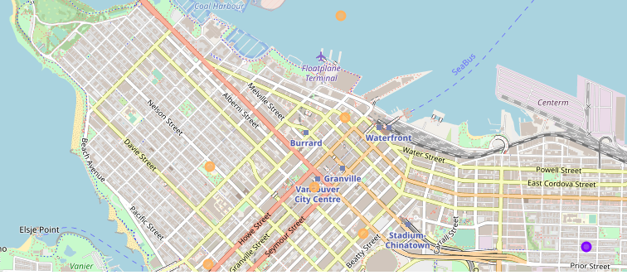
Results
Cluster 3 most suitable for investment

